Slide 1
REDUCING CARBON FOOT-PRINT BY OPTIMIZING IOT DEVICE USAGE
PIP2001 Capstone Project
VIVA-VOCE
Batch Number : CIT-G21
Under the Supervision of,
Dr./Mr./Ms./Prof. Dr. Mohana S D
Professor / Associate Professor / Assistant Professor
School of Computer Science and Engineering
Presidency University
Roll Number | Student Name
20211CIT0166 | DURGA PRASHEENA
20211CIT0042 | VENKAT NAVYA S
20211CIT0170 | CHAVVA RAJESWARI
20211CIT0164 | CHALLA SHALINI
Name of the Program: B.Tech (CSE-IOT)
Name of the HoD: Dr. Anandaraj S P
Name of the Program Project Coordinator: Dr. sharmasth vali Y
Name of the School Project Coordinators: Dr. Sampath A K / Dr. Abdul Khadar A / Mr. Md Ziaur Rahman

Slide 2
INTRODUCTION
The proliferation of Internet of Things (IoT) devices has revolutionized industries, transforming how we interact with technology and manage resources. These interconnected devices streamline operations, enhance convenience, and drive innovation across sectors. However, the rapid adoption of IoT has also raised significant concerns regarding energy consumption and environmental impact.
IoT devices often operate continuously, consuming electricity and generating data that require energy-intensive storage and processing. This growing energy demand contributes to an increased carbon footprint, exacerbating global environmental challenges such as climate change. Addressing these challenges requires innovative approaches to optimize IoT device usage while maintaining their utility and efficiency.
This paper explores strategies for reducing the carbon footprint associated with IoT devices through intelligent optimization techniques. By leveraging advanced technologies such as machine learning, energy-efficient hardware, and real-time analytics, IoT ecosystems can minimize energy consumption without compromising performance. Additionally, adopting sustainable practices in IoT device design, operation, and management can contribute to a greener and more sustainable future.

Slide 3
LITERATURE REVIEW
Reducing the carbon footprint through the optimization of IoT device usage has garnered significant attention in recent years. The Internet of Things (IoT), while offering immense benefits in connectivity and automation, contributes to energy consumption and carbon emissions due to the extensive use of sensors, devices, and data centers. Studies emphasize that energy-efficient designs, smarter algorithms, and adaptive technologies can play a pivotal role in mitigating these effects. Implementing energy-aware protocols, such as low-power communication technologies, and leveraging edge computing to reduce data transfer to centralized servers are proven strategies to lower energy demands. Furthermore, optimizing IoT deployment through predictive maintenance and scheduling can minimize unnecessary operations, thus conserving energy. The integration of renewable energy sources into IoT systems has also been highlighted as a key measure to reduce their reliance on non-renewable resources. Policies promoting sustainable IoT practices, combined with advances in artificial intelligence and machine learning, enable more precise energy usage predictions and dynamic adjustments. This synergy between technological advancements and environmental consciousness underscores the potential of IoT in contributing to global carbon reduction efforts. However, further research is needed to address challenges such as scalability, cost, and implementation barriers in real-world applications.

Slide 4
RESEARCH GAPS IDENTIFIED
While significant progress has been made in reducing the carbon footprint through IoT optimization, several research gaps remain. One critical gap lies in the lack of standardized frameworks for assessing the energy efficiency and environmental impact of IoT devices across diverse industries. Current studies often focus on specific applications, leaving a need for generalized, scalable solutions applicable to a broader range of use cases. Additionally, limited research exists on the integration of IoT systems with renewable energy sources at scale, particularly in decentralized and resource-constrained environments. The complexity of balancing performance and energy efficiency in real-time IoT applications, such as smart cities and industrial automation, also warrants deeper exploration. Moreover, the environmental cost of IoT device manufacturing, maintenance, and disposal is often overlooked in carbon footprint analyses, highlighting the need for a life-cycle approach. Ethical concerns, such as data privacy and equitable access to energy-efficient IoT technologies, further complicate adoption in developing regions. Lastly, while AI and machine learning show promise for optimizing energy usage, their computational demands and carbon emissions pose challenges that require innovative solutions. Addressing these gaps is essential to fully realize the potential of IoT in sustainable development.

Slide 5
PROPOSED METHODOLOGY
The proposed methodology for reducing the carbon footprint through IoT device optimization involves a multi-faceted approach combining energy-efficient design, intelligent resource management, and renewable energy integration. First, IoT devices will be equipped with low-power hardware components and energy-aware protocols to minimize energy consumption during operation and communication. Next, edge computing and local data processing will be implemented to reduce the reliance on energy-intensive cloud infrastructure, thereby limiting data transfer and associated emissions. AI-powered algorithms will be utilized to predict energy usage patterns, enabling dynamic adjustments and scheduling to optimize device performance while conserving energy. Renewable energy sources, such as solar and wind power, will be integrated into IoT systems to reduce dependence on non-renewable energy. Additionally, a life-cycle analysis approach will be adopted to assess the environmental impact of IoT devices from manufacturing to disposal, ensuring sustainable practices throughout their usage. Pilot projects in smart cities and industrial IoT environments will validate the effectiveness of these strategies, providing scalable and adaptable solutions. This comprehensive methodology aims to align IoT advancements with global sustainability goals, reducing carbon emissions without compromising functionality or efficiency.

Slide 6
PROPOSED METHODOLOGY
Random Forest Classifier:
The Random Forest is one of the ensemble-based machine learning approaches that involve constructing multiple decision trees to boost accuracy in the prediction and prevent overfitting. Each individual decision tree in the model will get trained over a random subset of data and over a random subset of features; thus, helping the model manage complex and high-dimensional data rather easily. In the IoT energy optimization domain, Random Forest can predict patterns in the consumption of energy and classify the devices according to their energy efficiency while identifying behavioral anomalies. This processes historical usage data, which is optimized for scheduling devices and reducing idle times and enhancing power management. All this reduces waste energy consumption and subsequently lowers operation costs and reduces carbon footprint. More than that, feature importance scores for Random Forest determine what factors are more critical in impacting energy consumption by device usage frequency, environmental conditions, and even interaction with other devices. With these insights, energy optimization strategies can be optimized to be even more targeted and effective. With its robustness, scalability, and the ability to handle large noisy datasets, Random Forest is a very fitting solution for IoT environments where a lot of real-time data are generated.

Slide 7
PROPOSED METHODOLOGY
Decision Tree Classifier:
The Decision Tree Classifier is a machine learning algorithm that can be used in this project to optimize IoT energy usage. It works by creating a model based on input features such as device activity, time of day, and environmental conditions, which are used to predict energy consumption patterns and determine the optimal operation mode for IoT devices (e.g., active, idle, or low-power). The Decision Tree splits the dataset at each node with the most significant feature that leads to a predicted outcome at the leaf nodes. Scheduling of power management via this approach classifies different devices into different types of operational states, hence avoiding unnecessary energy consumption. Decision Trees are advantageous due to interpretability and because they can process numeric and categorical values, thus applicable for the most IoT systems. They also exhibit several disadvantages like overfitting; this could be prevented with techniques like pruning. In the project, Decision Tree Classifier could be used for forecasting energy requirements, classifying states of devices, and scheduling so as to save a lot of wasted energy that brings sustainability and economy in the operation of the IoT.

Slide 8
PROPOSED METHODOLOGY
XGBoost Classifier:
XGBoost is an extremely strong machine learning algorithm that can be applied to optimize the energy usage of IoT. XGBoost is an ensemble technique of decision trees through boosting, where the mistake committed by the previous tree is rectified. The result will be very accurate predictions. This will enable XGBoost to predict the pattern of energy consumption, taking features such as usage of device, time, and environmental conditions. This will enable proactive energy management, for example, to decide when the best time is to put devices in low-power or idle states. The benefits of using XGBoost include high precision, efficiency, and ability to handle large-scale data; plus, the incorporation of regularization mechanisms avoids overfitting. Though tuning the parameters are necessary, careful attention must be applied for parameter fitting; the explanation capability is inferior compared to the decision tree approach. Nevertheless, XGBoost has an adequate potential for proper energy forecasts in a system with optimum behavior of a device in big IoT systems, hence contributing toward sustainable consumption, energy, and savings on the deployment costs.

Slide 9
PROPOSED METHODOLOGY
SVC Model:
An efficient use of an SVC model will reduce the carbon footprint of IoT devices. The SVC model can well analyze historical data, such as sensor readings, device usage patterns, or environmental conditions, to predict the behavior of the device with a high degree of accuracy. This prediction ability forms the basis of predictive maintenance; that is, it allows one to schedule tasks beforehand while minimizing continuous monitoring, thereby reducing energy consumption. The SVC model can even optimize data gathering by detecting trends in data pointing toward critical changes or events. This will reduce the frequency of data transmission as it collects data only when there is a drastic change, saving much energy. The model can also dynamically alter the power consumption of IoT devices according to realtime conditions and the predicted needs. For instance, it would be programmed during periods of low activity to have the devices turned off temporarily or to a low-power mode during those times. In such an approach, usage of energy would greatly be reduced while the emissions of carbon are greatly minimized in contrast; this ensures the IoT works in efficient and reliable manners.

Slide 10
OBJECTIVES
The primary objectives of reducing the carbon footprint by optimizing IoT device usage are to enhance energy efficiency, promote sustainable practices, and support global carbon reduction goals. This involves developing low-power IoT systems and implementing energy-aware protocols to minimize energy consumption during device operation and data transmission. Another key objective is to leverage advanced technologies, such as edge computing and artificial intelligence, to optimize resource management and reduce reliance on energy-intensive cloud infrastructure. Additionally, the integration of renewable energy sources into IoT systems aims to reduce dependence on fossil fuels, further decreasing environmental impact. Encouraging a life-cycle perspective on IoT devices, from design and manufacturing to deployment and disposal, ensures sustainability at every stage. By achieving these goals, the initiative seeks to balance technological innovation with environmental responsibility, enabling industries, governments, and individuals to adopt IoT solutions that are both efficient and eco-friendly.

Slide 11
SYSTEM DESIGN AND IMPLEMENTATION
The system design and implementation for reducing the carbon footprint through IoT device optimization involve creating an energy-efficient architecture that prioritizes sustainability at every level. The design incorporates low-power IoT hardware and communication protocols, such as Zigbee or LoRaWAN, to minimize energy consumption during operation. A decentralized structure using edge computing is employed to process data locally, reducing reliance on energy-intensive cloud data centers. The system integrates AI-driven algorithms to analyze energy usage patterns and dynamically adjust operations to optimize efficiency. Renewable energy sources, such as solar panels or wind turbines, are incorporated to power IoT devices, further reducing dependence on non-renewable resources. A centralized dashboard is developed for real-time monitoring and management of energy consumption across connected devices, providing actionable insights for optimization. The implementation phase includes deploying the system in pilot environments, such as smart homes or industrial facilities, to test and refine its effectiveness. Feedback from these deployments informs iterative improvements, ensuring the system is scalable, cost-effective, and adaptable to diverse use cases. This holistic approach enables a sustainable IoT ecosystem that aligns with global carbon reduction efforts.

Slide 12
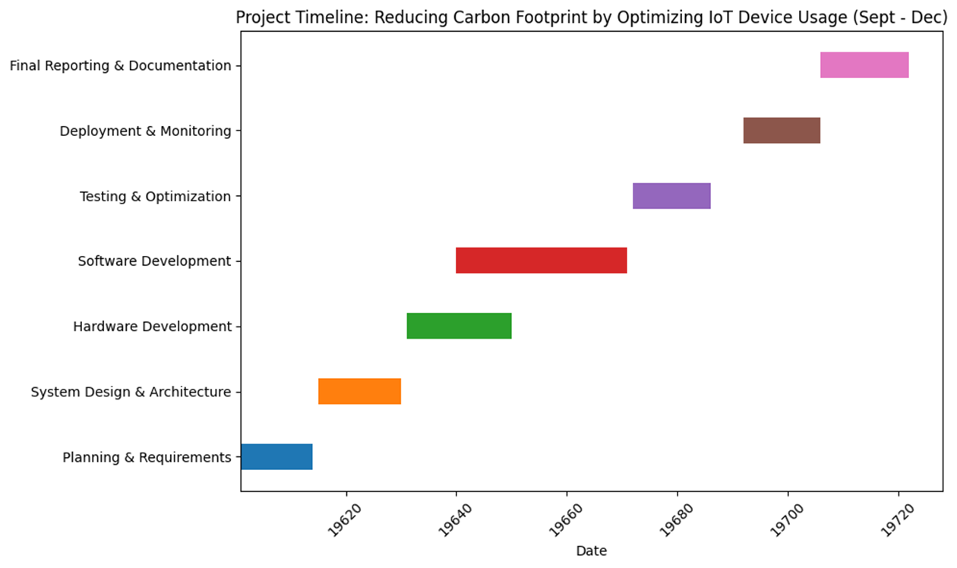
TIMELINE OF THE PROJECT

Slide 13
OUTCOMES / RESULTS OBTAINED
The outcomes of reducing the carbon footprint by optimizing IoT device usage are expected to significantly contribute to environmental sustainability and energy efficiency. By implementing low-power hardware, energy-aware protocols, and edge computing, IoT systems will consume less energy, directly lowering carbon emissions. The integration of renewable energy sources, such as solar and wind, will further reduce reliance on fossil fuels, promoting cleaner energy usage. AI-driven optimization will ensure smarter resource allocation and predictive energy management, minimizing waste and improving operational efficiency. Additionally, real-time monitoring and management systems will provide actionable insights, enabling users to make data-driven decisions to further enhance sustainability. These advancements will not only reduce the overall carbon footprint of IoT ecosystems but also serve as a scalable model for industries, smart cities, and individuals seeking to adopt eco-friendly technologies. Ultimately, this approach will contribute to achieving global sustainability goals, such as those outlined in the Paris Agreement, and foster a greener, more energy-efficient future.

Slide 14
CONCLUSION
In conclusion, optimizing IoT device usage presents a transformative opportunity to reduce the carbon footprint and contribute to global sustainability efforts. By adopting energy-efficient hardware, leveraging advanced technologies like edge computing and AI-driven optimization, and integrating renewable energy sources, IoT systems can significantly lower energy consumption and emissions. A life-cycle perspective ensures that environmental considerations extend from manufacturing to disposal, further enhancing sustainability. While challenges such as scalability, cost, and standardization remain, ongoing research and innovation are paving the way for eco-friendly IoT ecosystems. This approach not only addresses environmental concerns but also supports industries, governments, and individuals in aligning technological advancements with sustainability goals. As IoT adoption continues to grow, these strategies provide a pathway to harness its potential while minimizing its environmental impact, fostering a greener and more responsible future.

Slide 15
REFERENCES
Islam et al. (2021): Proposed a renewable energy-based power supply architecture for offgrid HetNets arXiv:2110.05906 [cs.NI] (or arXiv:2110.05906v1 [cs.NI] for this version) https://doi.org/10.48550/arXiv.2110.05906
Liu et al. (2019): Introduced a cross-layer design to enhance IoT energy efficiency on edge devices. arXiv:1901.05494 [eess.SP] (or arXiv:1901.05494v2 [eess.SP] for this version) https://doi.org/10.48550/arXiv.1901.05494
Towards Energy Efficient Home Automation: A Deep Learning Approach Sensors 2020, 20(24), 7187; B. Johnson et al. (2020) https://doi.org/10.3390/s20247187
Energy Prediction in IoT Systems Using Machine Learning Models E. Kumar et al. (2022) https://doi.org/10.32604/cmc.2023.035275
Buildings." Environmental Data Science , Volume 3 , 2024 , e1 DOI: https://doi.org/10.1017/eds.2023.43

Slide 16
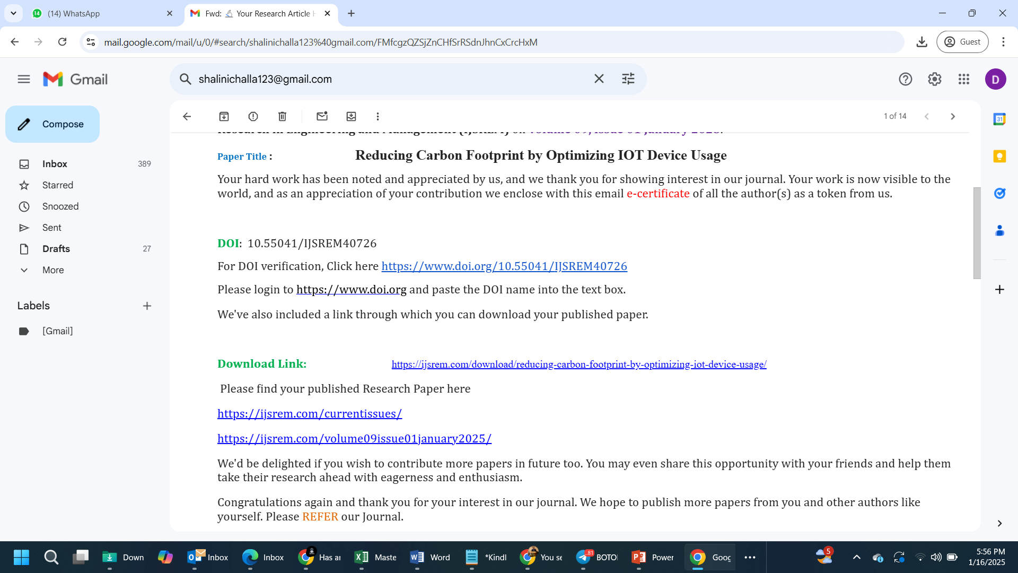
PUBLICATION DETAILS

Slide 17
PSUEDO CODE
Code in Anaconda:
Steps to create the virtual environment
1.conda create -n leaf_disease python=3.7
2.conda activate leaf_disease
3.pip install ipykernel
4.python -m ipykernel install --user --name leaf_disease --display-name "leaf_disease"
Random Forest Classifier:
X_train, X_test, y_train, y_test = train_test_split(X, y, test_size=0.2, random_state=42)
model = RandomForestClassifier(n_estimators=100, random_state=42)
model.fit(X_train, y_train)
accuracy = accuracy_score(y_test, model.predict(X_test))
print(f"Model Accuracy: {accuracy:.2f}")
joblib.dump(model, "sensor_model.pkl")
from sklearn.metrics import confusion_matrix, classification_report, accuracy_score, log_loss
import seaborn as sns
import matplotlib.pyplot as plt
import joblib
model = joblib.load("sensor_model.pkl")
y_pred = model.predict(X_test)
y_pred_proba = model.predict_proba(X_test)
accuracy = accuracy_score(y_test, y_pred)

Slide 18
CONTINUATION
print(f"Model Accuracy: {accuracy:.2f}")
conf_matrix = confusion_matrix(y_test, y_pred)
plt.figure(figsize=(6, 5))
sns.heatmap(conf_matrix, annot=True, fmt="d", cmap="Blues", xticklabels=model.classes_, yticklabels=model.classes_)
plt.title("Confusion Matrix")
plt.xlabel("Predicted")
plt.ylabel("True")
plt.show()
class_report = classification_report(y_test, y_pred)
print("\nClassification Report:\n", class_report)
loss = log_loss(y_test, y_pred_proba)
print(f"Log Loss: {loss:.2f}")

Slide 19


